Slide 1

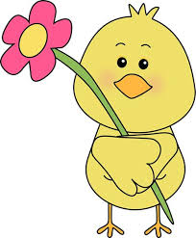
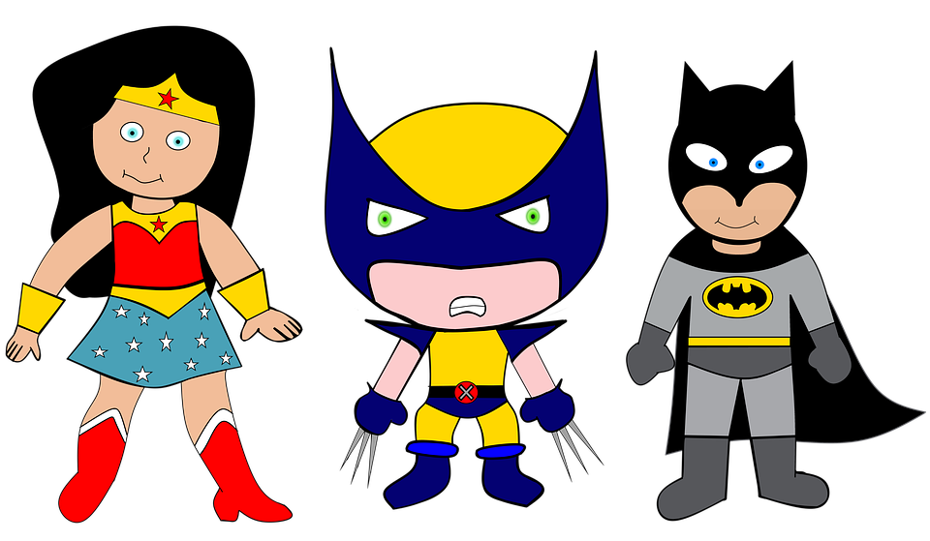

We are SUPERheroes!
Students Using their Powers to Engage in Reading!
Kindergarten Newsletter – April 18-22, 2022
IMPORTANT EVENTS
Breakfast ends at 7:25!
4-18 4-21 | No school Easter break Progress Reports & Cap and Gown Pictures
The EXPERT in anything was once a BEGINNER!
HOMEWORK
Mon. – Thurs. | Weekly ELA Sheet Math HW Pages Practice Sight Words List Read 10 minutes per night
SCHOOL NEWS
Our new Phonics program starts promptly at 7:45 a.m. everyday, so be sure your child is here before 7:30 a.m. We don’t want them to miss a minute of learning!
WEEKLY ASSESSMENTS
ELA | Module 8.2 listening test Oral Reading Fluency test Spelling test: box, fox, got, log, lot, mom, not, pot, top
Math | Lesson 26 and 27 test
WEEKLY MATH SKILLS
Measurement / shapes Writing 1-20 Teen numbers Counting to 100 by tens and ones Adding/subtracting to 10
REMINDERS
Please make sure all money is sent in your child’s blue folder labeled and sealed. If your child is absent, please send an excuse labeled with the following information: Child’s name, date of absence, teacher’s name, and reason for absence.
SCHOOL SAFETY
Be sure your child wears a mask to school DAILY!

Slide 2
Module 8 Week 2: From Plant to Plate!
LEARNING MINDSET: Problem Soving
ESSENTIAL QUESTION
How do plants become food?
PHONICS
Introduce: digraphs & short and long vowels & blends
READING
Genre: Fiction Story Elements: Characters, Settings, Events Informational Texts | Listening Comprehension Parts of a Book Collaborative discussions
WORDS TO KNOW
Home Like Many Right
VOCABULARY
BIG IDEA WORDS: garden, harvest, plant POWER WORDS: burrow, soil, vine Books: Up in the Garden and Down in the Dirt and Earthworms
REVIEW
Letters and sounds Aa-Ff Gg-Pp Qq-Zz
WRITING
Nouns and Verbs Characters/Setting Narratives
SPELLING WORDS
box fox got log lot mom not pot top
PHONEMIC AWARENESS
Identify Rhymes Identify Syllables Beg., Medial, Final Sounds

